Slide 1
BCD to Gray Code Converter and Gray Code to BCD Converter
Done by: Gautham P Nair
Shravan Krishna S
(Group 19)
Subject: Logic Circuit Design-Course Project

Slide 2
Introduction
The design and implementation of a Binary Coded Decimal (BCD) to Gray Code converter and its reverse, Gray Code to BCD, are explored in this project.
Gray code is widely used in digital systems to minimize errors during transitions between states.
This project utilizes Verilog to model a converter that transforms BCD to Gray Code and also reverses the process to convert Gray Code back to BCD.
This system is essential in digital communication for reducing transition errors and is implemented and tested on an FPGA to validate its functionality.

Slide 3
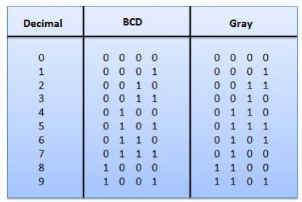
Figure 1 : BCD to Gray code Truth table

Slide 4
Objective
The primary objectives of this project are:
To design and implement a BCD to Gray code converter.
To design and implement the reverse conversion from Gray code to BCD.
To understand the use of encoding/decoding in reducing transition errors in digital systems.
To implement the conversion in Verilog and verify it through Field Programmable Gate Array (FPGA) hardware testing.

Slide 5
Scope
This project covers:
The conversion between BCD and Gray code and vice versa.
Implementation of error-minimization techniques in digital communication.
Testing through FPGA hardware and simulation tools.
Potential applications in digital systems such as error correction, rotary encoders, and ADCs.

Slide 6
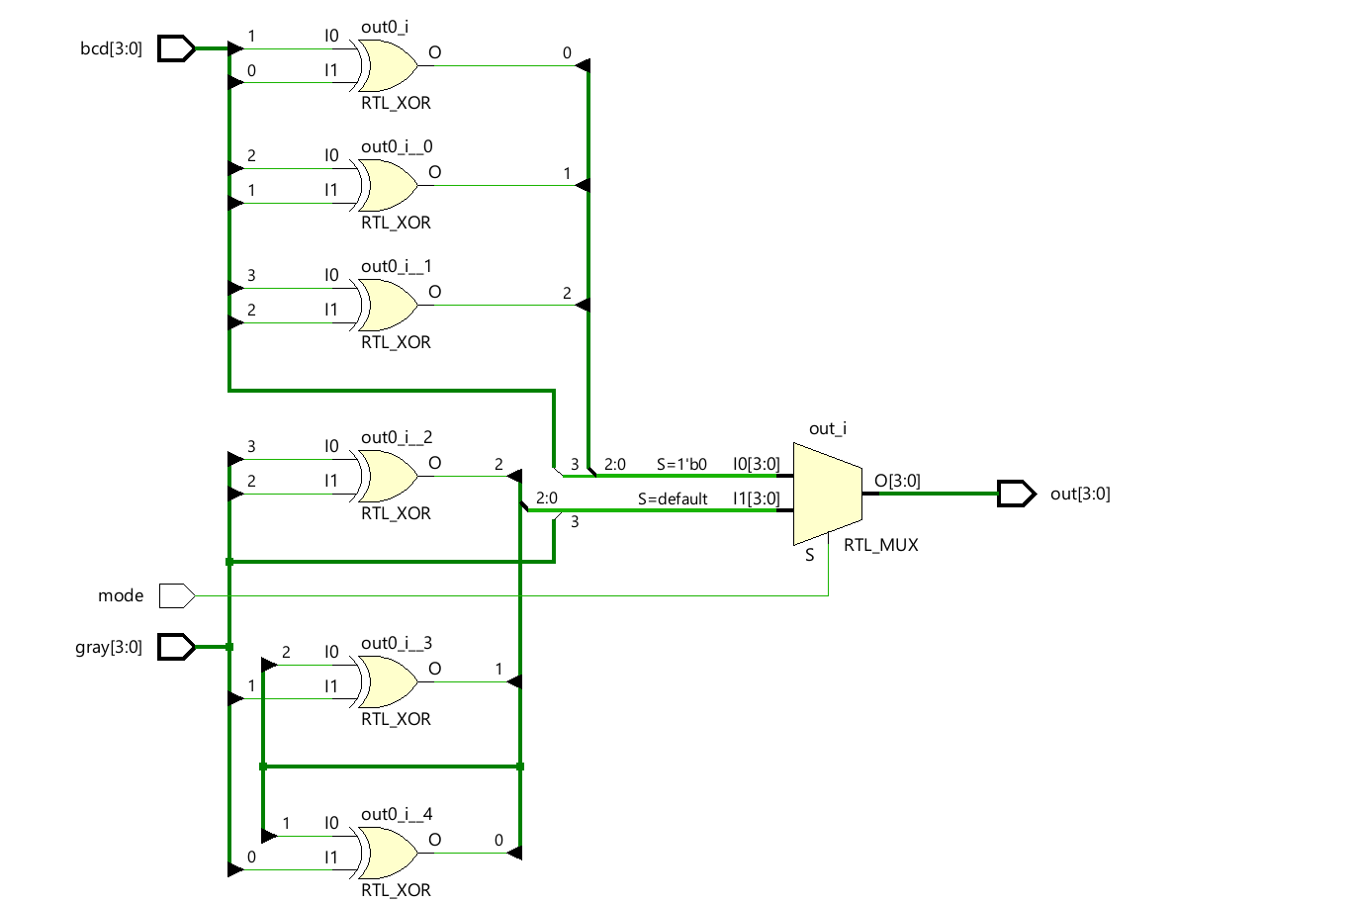
Block Diagram
Figure 2 : Schematic Diagram

Slide 7
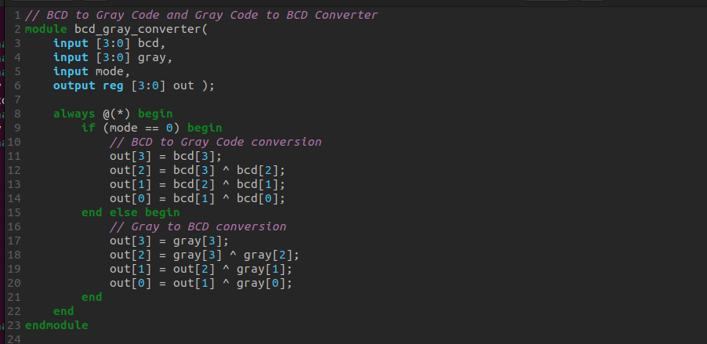
Design
Figure 3 : Icarus verilog model

Slide 8
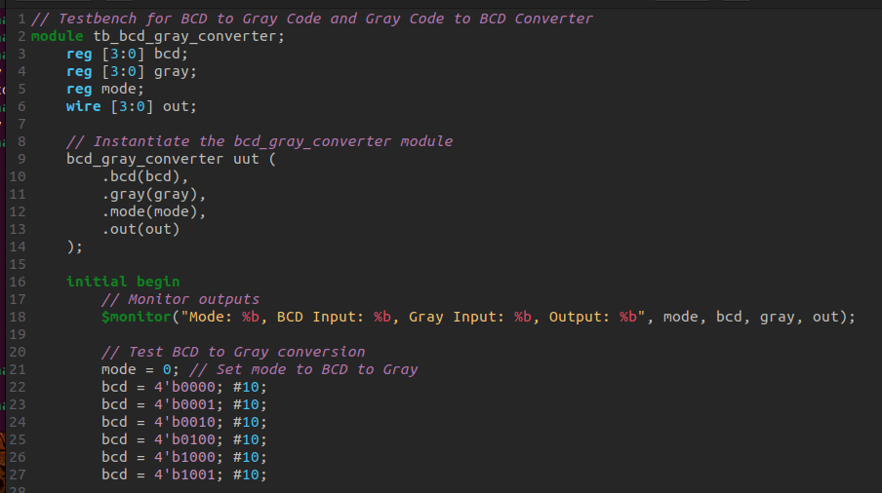
Figure 4 : Icarus verilog testbench

Slide 9
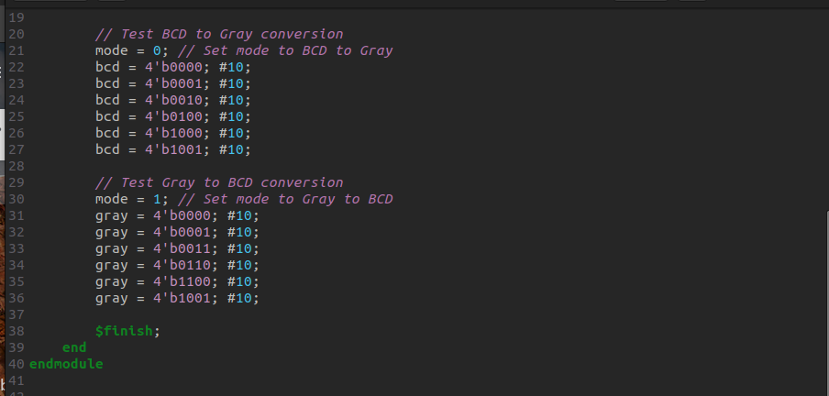
Figure 5 : Icarus verilog testbench

Slide 10
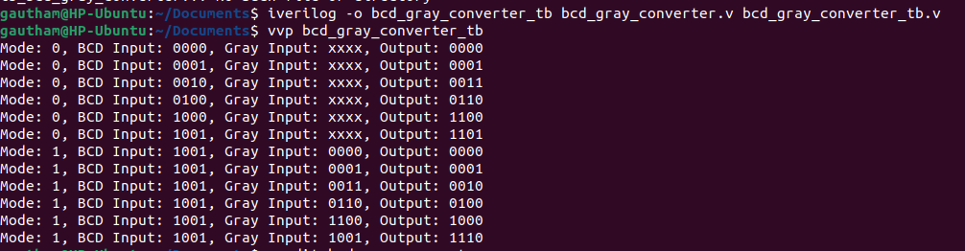
Figure 6 : Icarus verilog output

Slide 11
Software and Hardware Requirements
Software:
Xilinx ISE/Vivado (for simulation and verification).
Icarus verilog (for writing and simulating Verilog code).
GTK Wave (for simulating Verilog code)
Hardware:
FPGA Development Board (Xilinx XC7S50-CSGA324-1 Spartan-7).
LEDs/Switches for inputting BCD/Gray code and displaying outputs.

Slide 12
Bill of Materials
Sl no | Component | Quantity | Description
1 | FPGA Development Board (Boolean FPGA Development Board Xilinx XC7S50-CSGA324-1 Spartan-7) | 1 | For implementing and testing logic

Slide 13
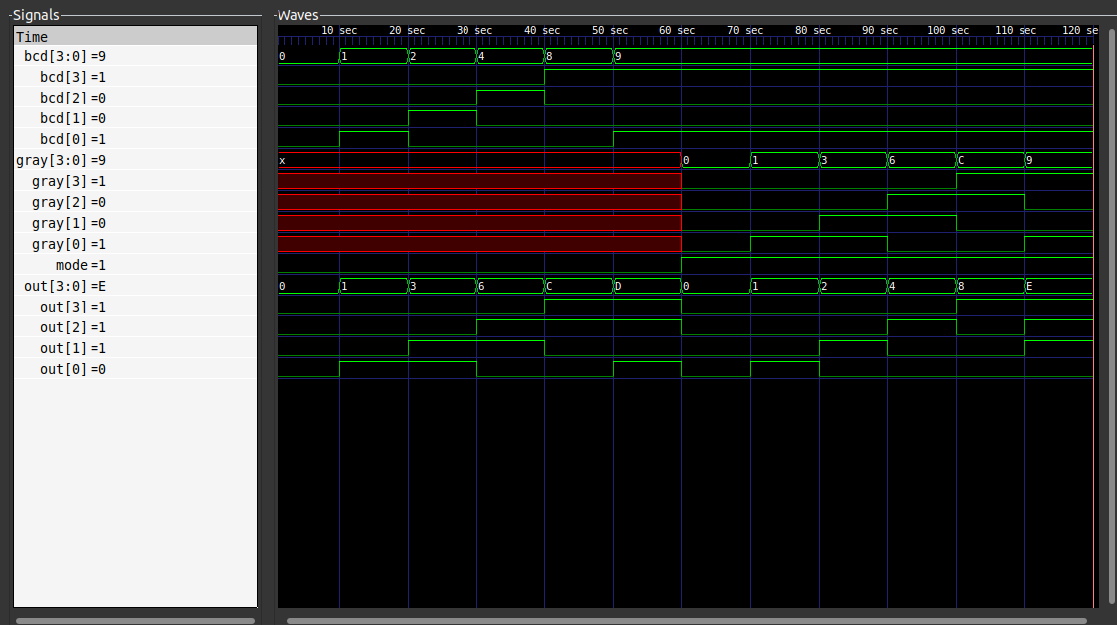
Simulation Output
Figure 7 : GTK wave simulation output

Slide 14
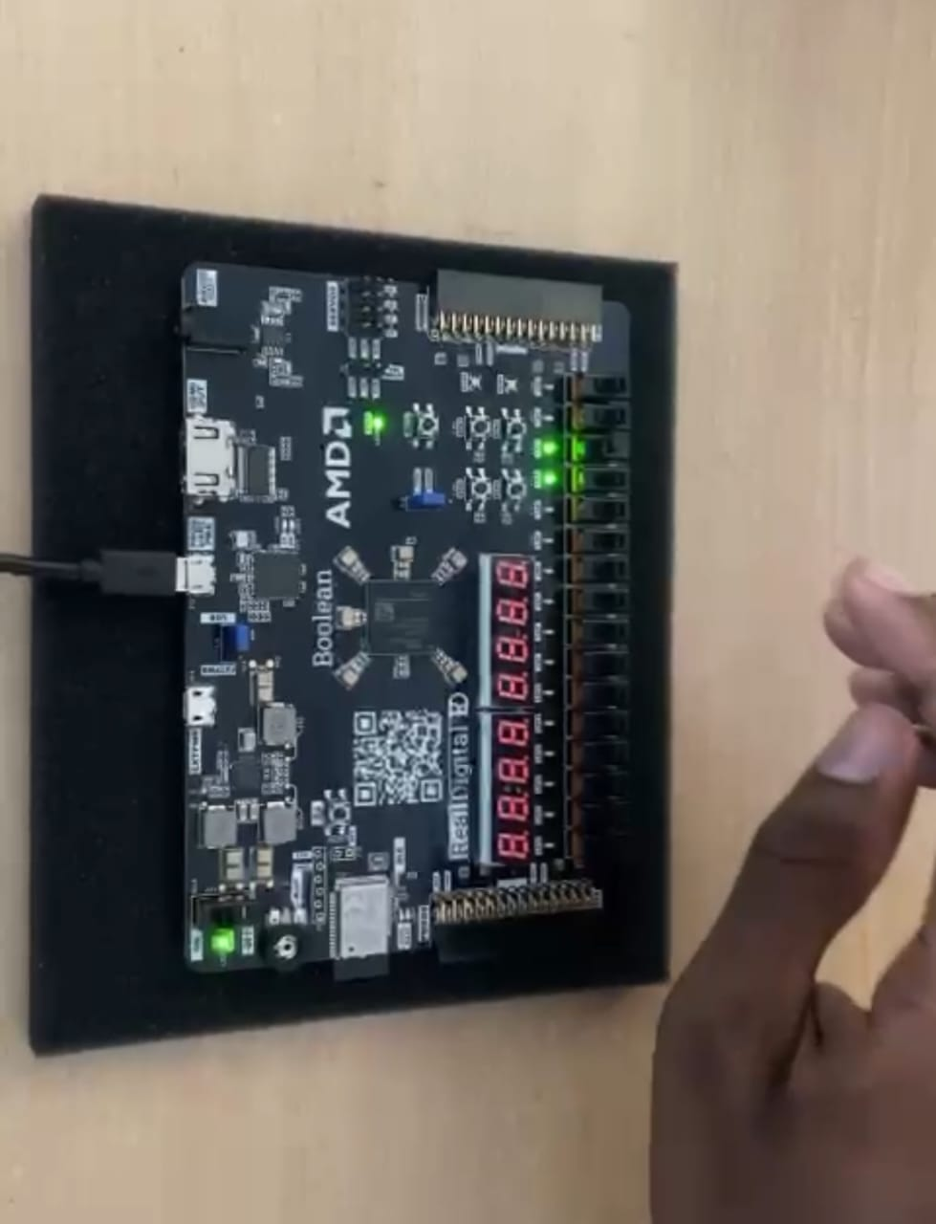
Implementation
Inputs:
Mode =0
bcd=0010
Output:
gray=0011

Slide 15
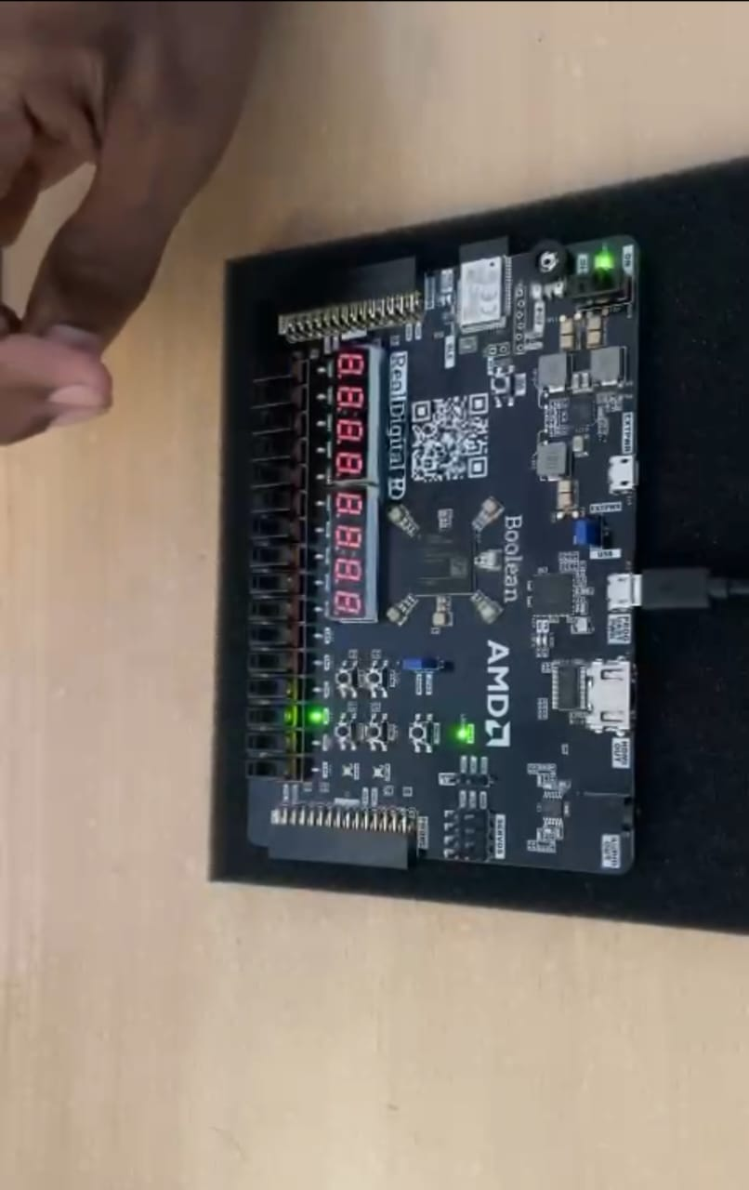
Implementation
Inputs:
Mode =1
gray=0011
Output:
bcd=0010

Slide 16
Conclusion
This project successfully demonstrates the conversion between BCD and Gray code and the reverse Gray code to BCD operation.
By using simple XOR logic, this project illustrates the application of encoding and decoding systems that minimize errors in high-speed digital systems.

Slide 17
References
Xilinx, "Vivado Design Suite User Guide: Logic Simulation," UG937 (v2020.1), May 2020. [Online]. Avaie at: https://www.xilinx.com/support/documentation/user_guides/ug937-vivado-simulation.pdf
M. Morris Mano, Digital Logic and Computer Design, 2nd ed. Prentice Hall, 2000.
Stephen Williams, "Icarus Verilog: A Verilog Simulation and Synthesis Tool," 2001. Available at Icarus Verilog.
EDA Playground, "Online EDA Tools for Verilog and VHDL," [Online]. Available at: https://www.edaplayground.com/.

Slide 18
Thank You

